Slide 1
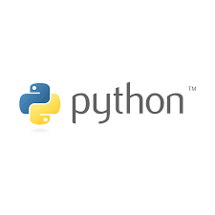



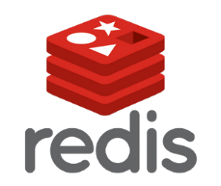
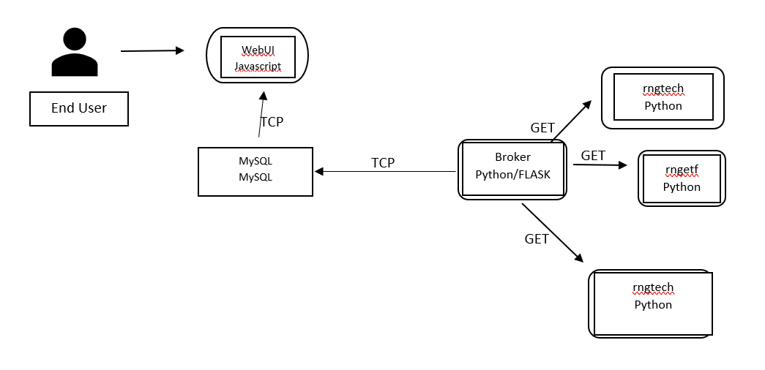

StockWatch
By: Jordan Gumby, Michael Hutz, Corah Krantz, and Mitch Moir
Challenges
No front end experience
Various tools and options
Interface with MySQL vs Redis
Manual Configuration
Data Collection for first iteration
Purpose
Provide a quick and easy to read dashboard for stocks.
Lightweight framework that’s easily managed
Customizable viewing to filter stocks most relevant
Log historical data for analysis purpose
Easily expandable to a larger sample size of stocks
Cloud hosted for real time updates at all times
Design:
Kubernetes Deployment into a Cloud platform will allow for real time updates in the background
All services will be installed and updated through automation on launch.
Python RNG generation files contain calculation
Calculations passed through by Broker API
API communicates with WebUI to display information from Redis DBMS
Demo will use Redis, final product will use MySQL for easy upscaling in production
Sample Layout
Tech
ETF
Crypto
View tabs
Historical Values
GitHub: https://github.com/Michael-Hutz/csc468_team_hmkg/tree/kubernetes-project

